Slide 1
Concepts & Examples: Lagrange, Divided Difference, and Cubic Spline Interpolations
Gabe and Ben

Slide 2
Intro & Similarities
We will be discussing some 1-D interpolation methods with some pros and cons:
Lagrange interpolation is suitable for small datasets, where analytically the interpolant function can closely mimic the true, unknown function.
Newton’s DD is an extension to the method above to increase precision. This works well with more unstructured datasets to iteratively compute parameters.
Cubic splines is more applicable to continuous dataset with higher uncertainty. Uses pairwise splines to map plausible function values at each interval.
Downsides to these techniques is that it doesn’t make good predictions on large datasets as these methods are heavily data dependent – Only taking into account subtle magnitude & gradient differences.

Slide 3
Lagrange Interpolation
The polynomial is constructed through a linear combination of Kronecker Delta functions with the function values at each point.
Assume you have a vector of your x values, the Kronecker Delta function is defined by a quotient in respect to the dependent variable at the function node. This quotient is a ratio on the product of the differences between non-target x values and target x value. Given this is a function, only the denominator holds a numeric value while the numerator is in terms of the dependent variable at node.
Examples: estimating population census data, tracking athletes cartesian coordinates

Slide 4
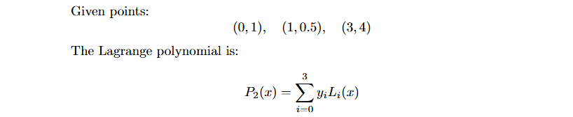
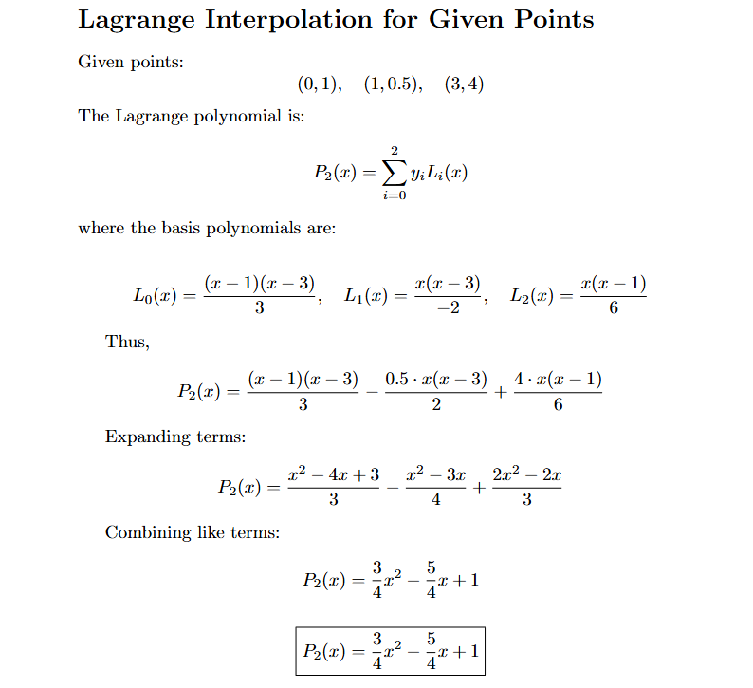

Slide 5
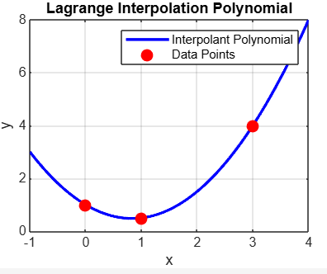

Slide 6
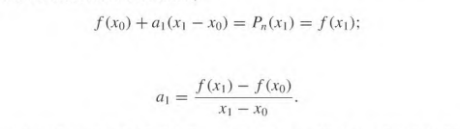

Newton’s Divided Difference
Divided differences is a more structured and recursive way to compute polynomials when getting additional data points.
Evaluating at x0 and x1 give us the following a terms which we can rewrite in divided difference notation.
Notes:
We express the nth interpolating polynomial as this Pn(x) where are a’s are constants that we need to determine using divided difference methods.

Slide 7

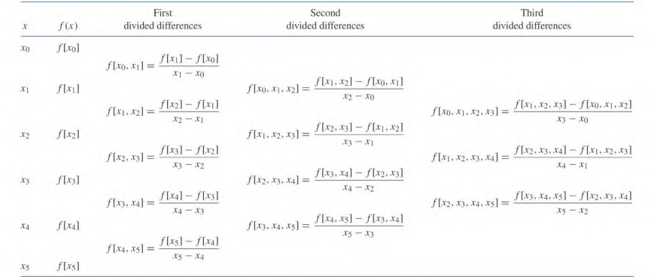
Divided Differences
nth divided difference

Slide 8
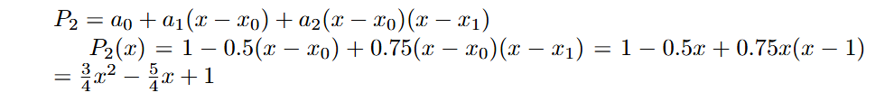
Divided Difference (ex.)
(0,1), (1,0.5), (3,4)
x | f(x) | 1st DD | 2nd DD
0 | 1 | -0.5 | 0.75
1 | 0.5 | 1.75
3 | 4

Slide 9
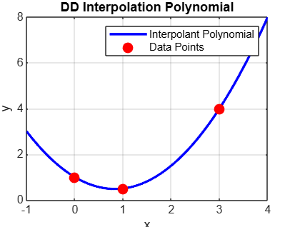

Slide 10
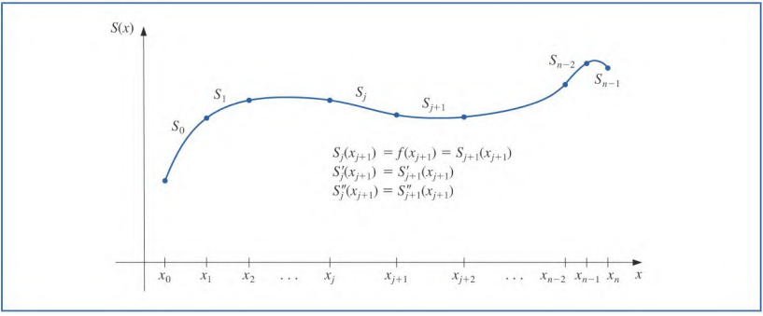
Cubic Splines
Given a set of data points, a cubic spline interpolant is a piecewise cubic function that passes through the given points while maintaining continuous first and second derivatives.
Notes:
Explain why cubic is better than linear and quadratic.

Slide 11
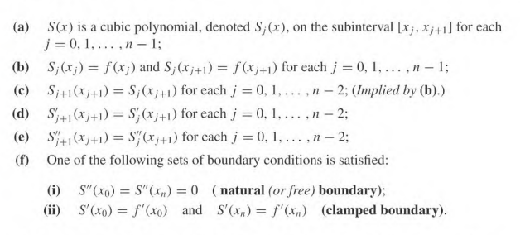
Cubic Splines
Given a function defined on [a, b] and a set of nodes a = x0 < x1 < …< xn = b, a cubic spline interpolant S for is a function that satisfies the following conditions:
Notes:
a) defines each Sj(x). b) interpolated curve should go through the given data points. c) follows from b saying cubic polynomials should meet at same point. d) 1st derivatives equal. e)second derivatives equal. f) endpoint boundaries.

Slide 12
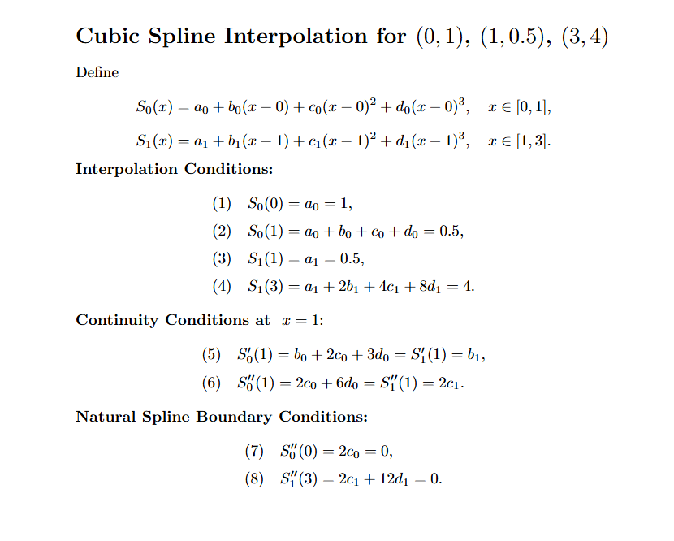
Notes:
Walk through example problem explaining setting up the system of equations to solve for coefficients.

Slide 13
